Slide 1
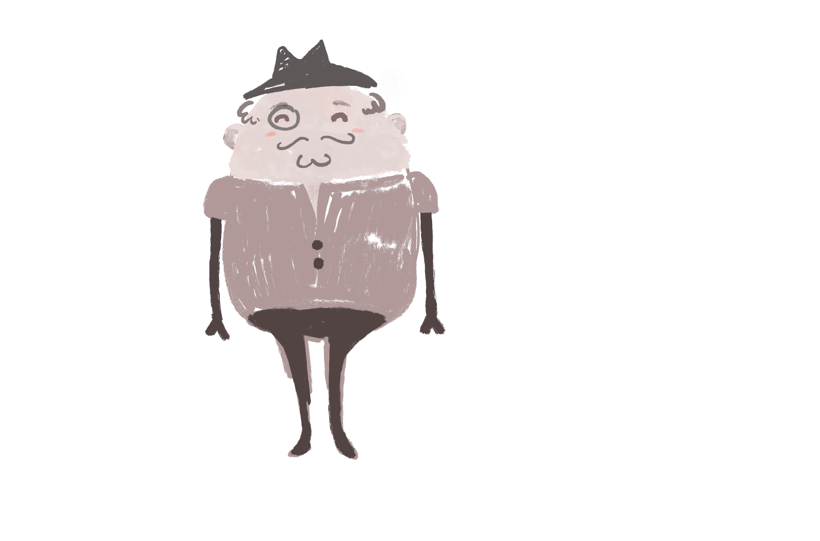


Slide 2


Black tea

Slide 3
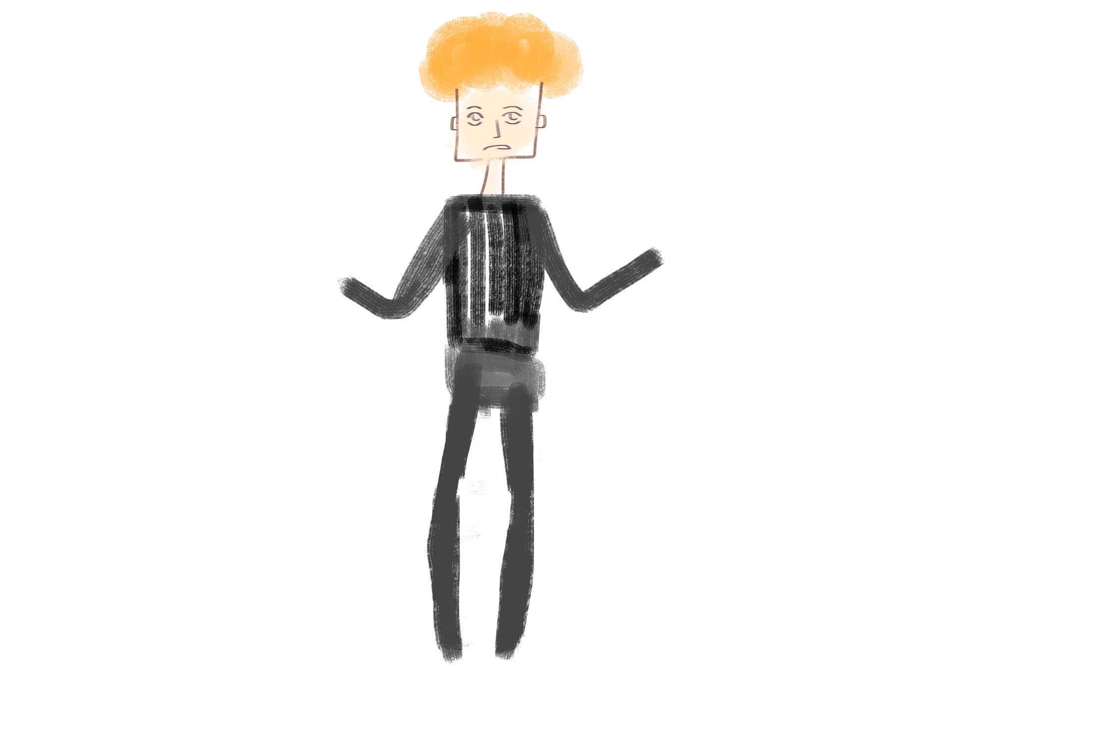
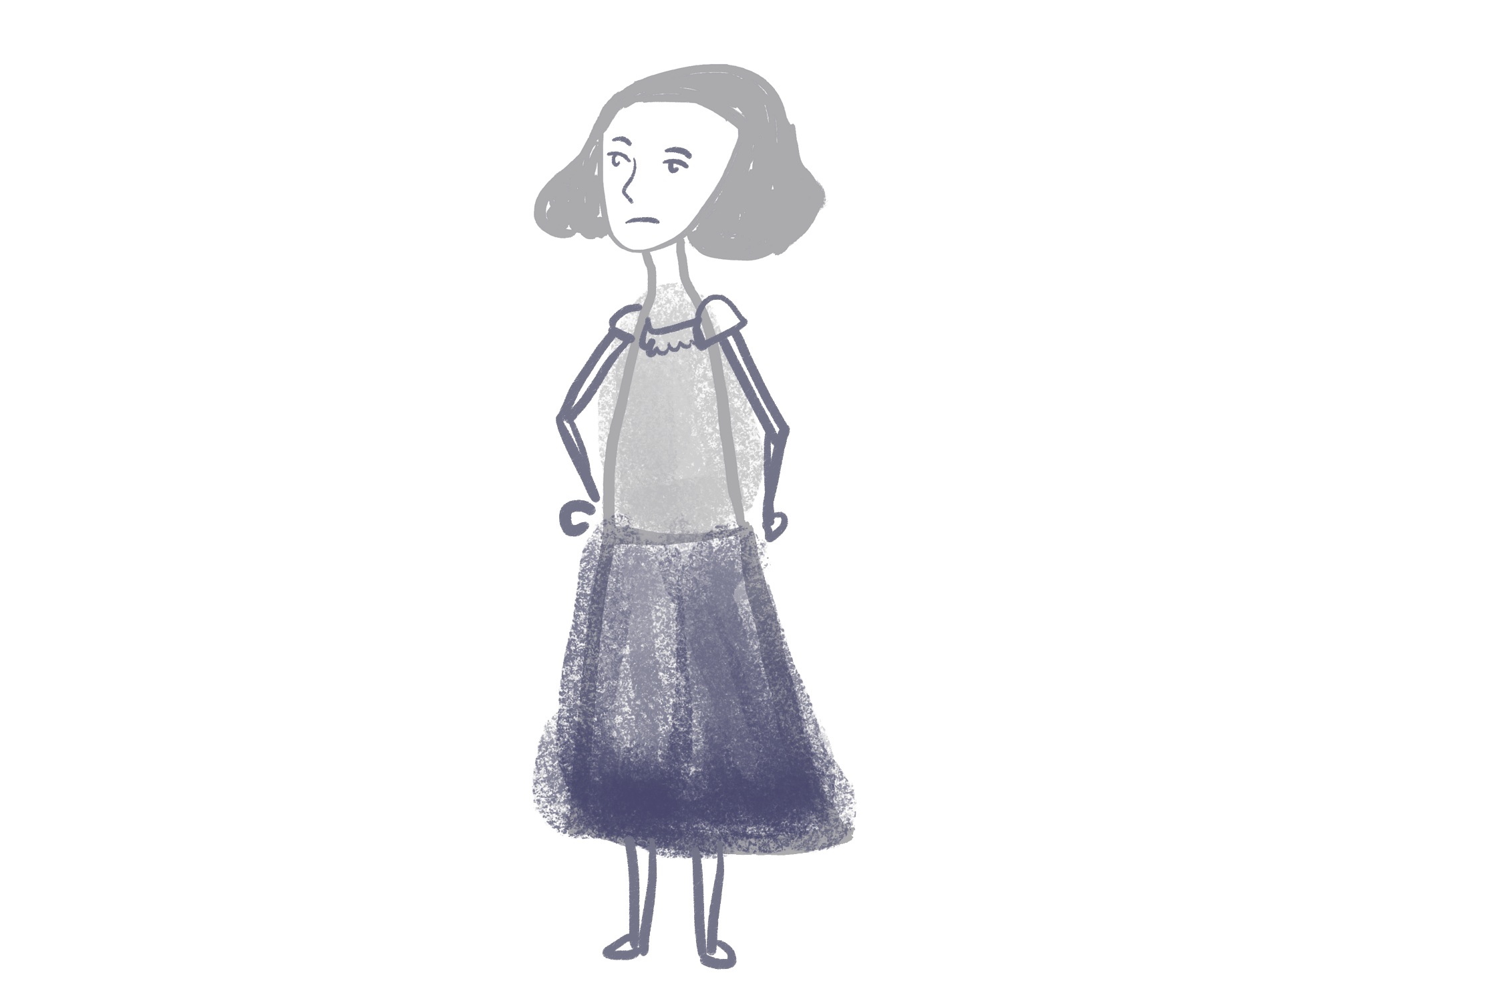
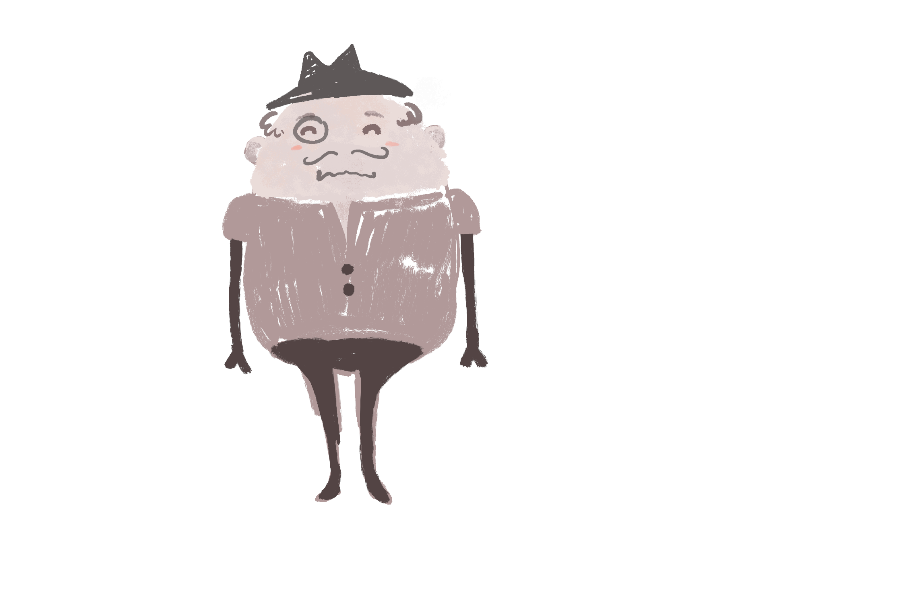

…a Hidden Markov Model!
Will
Jane

Slide 4
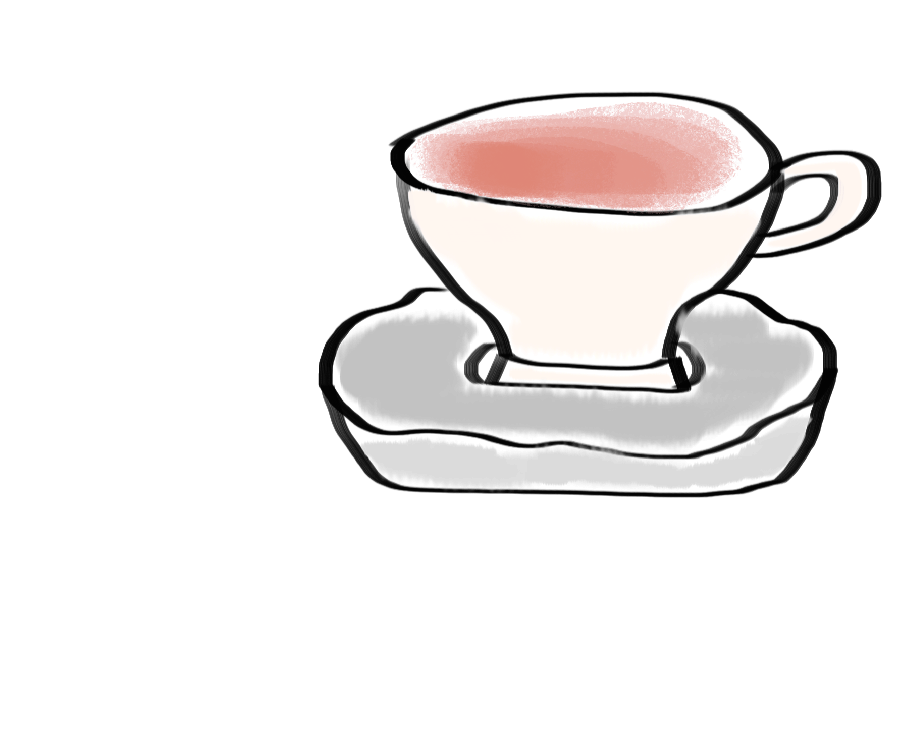
The internal states generate observations
Is my one purpose in life to make tea??!
Ex. Observation
Ex. Internal State

Slide 5
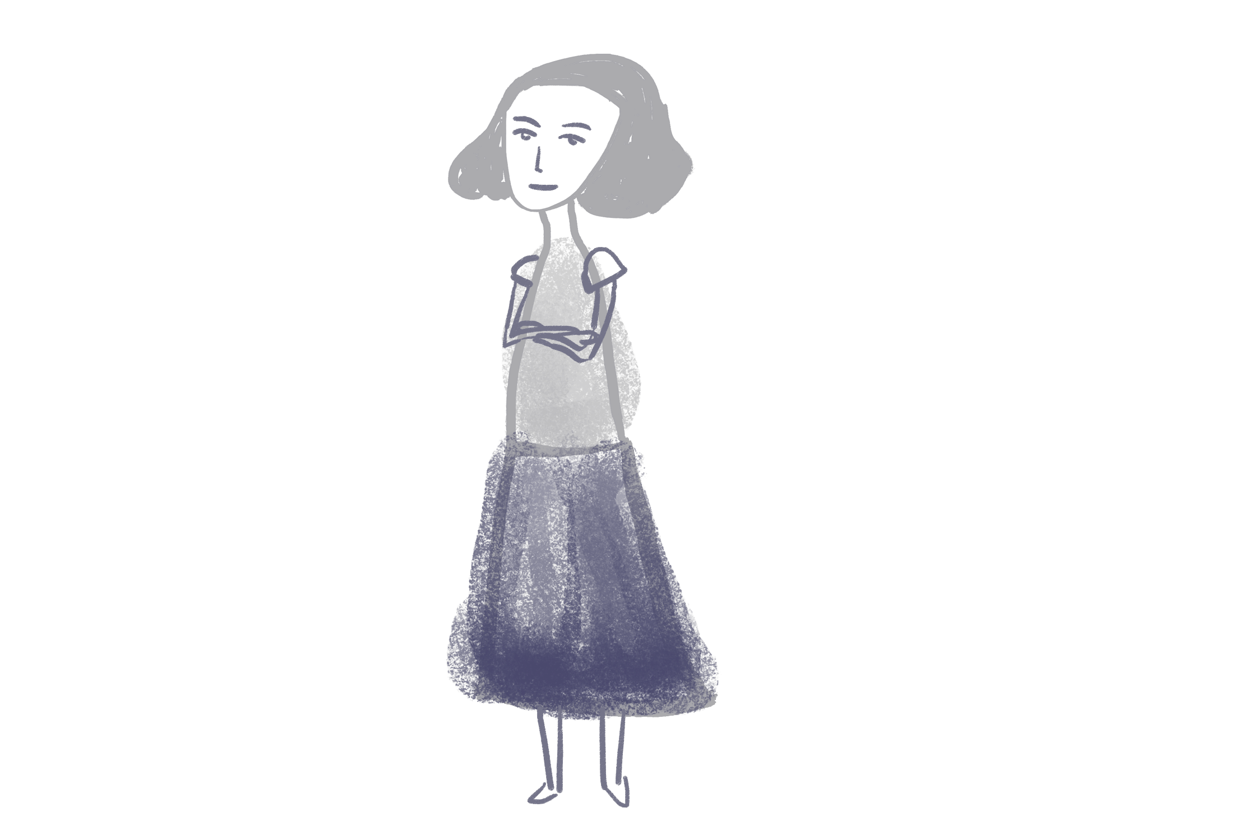
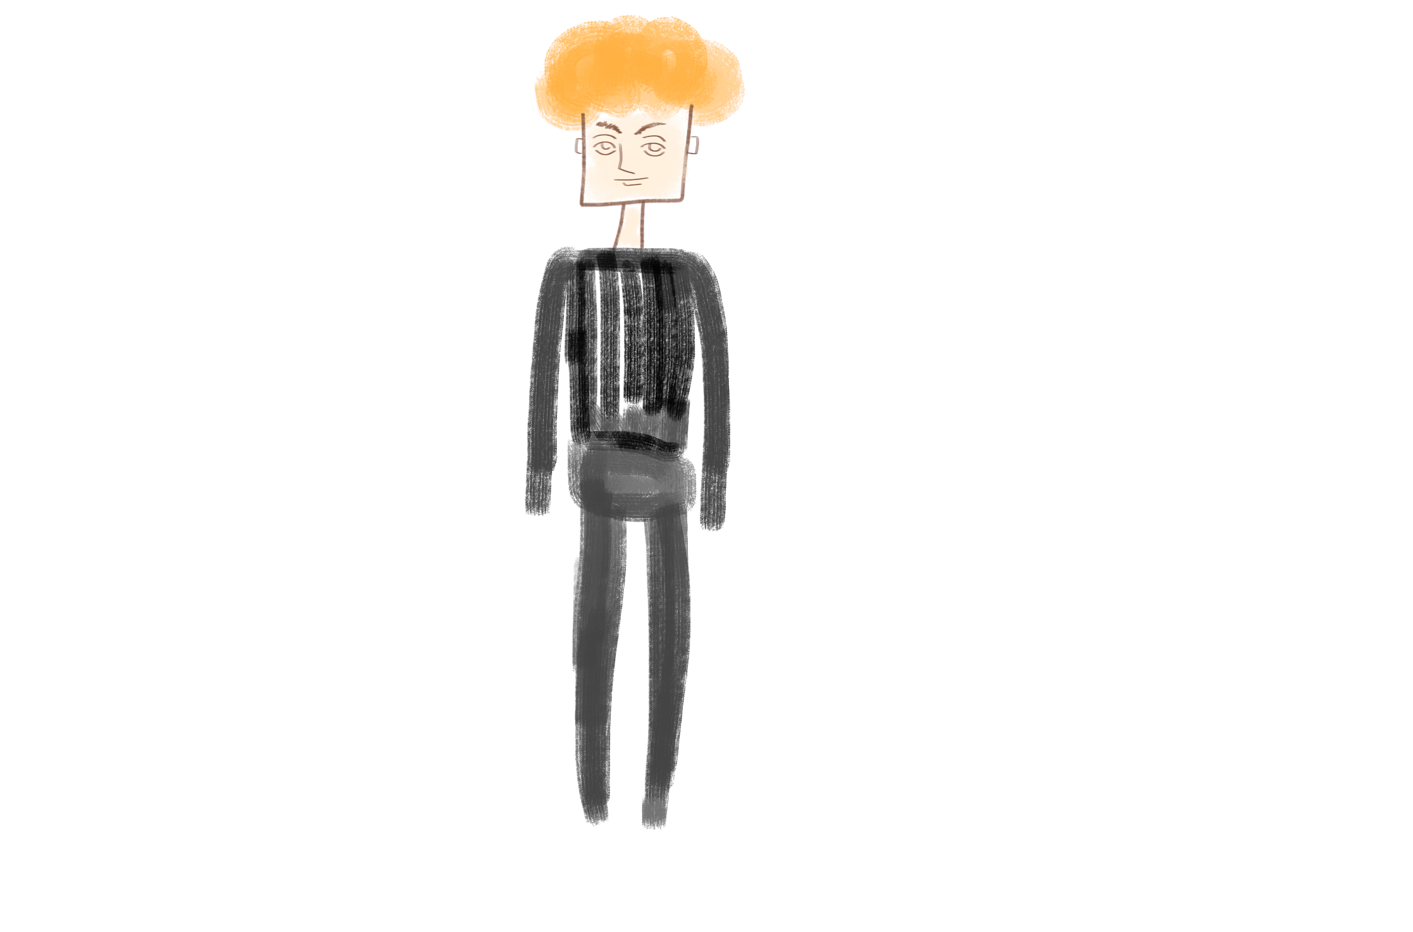
The internal states are hidden
Who’s the murderer? Dun-dun-DUNNN!!!
OR

Slide 6
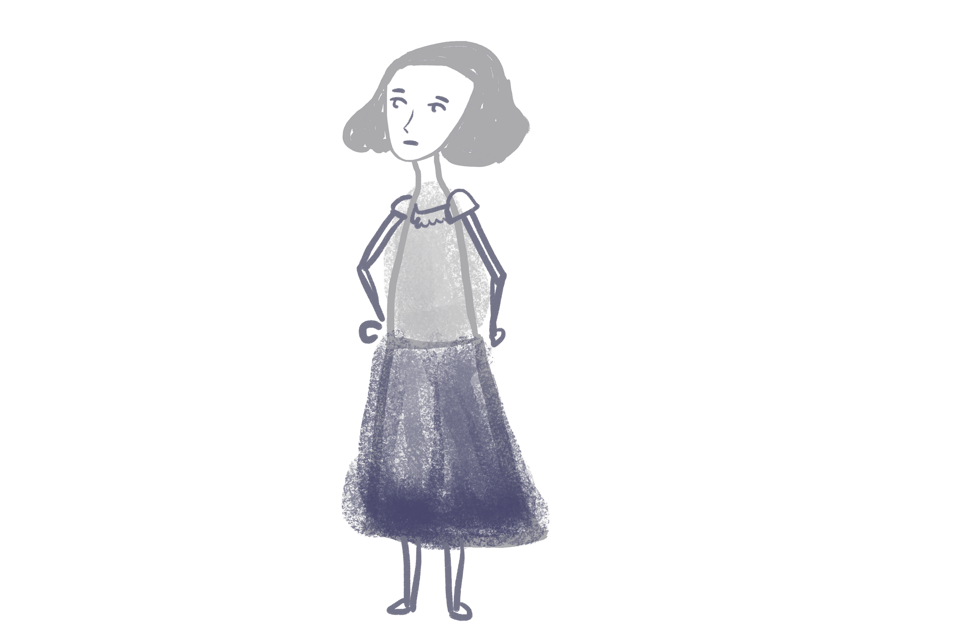
The current state depends on the previous state
(Markov process)
You go make the tea today!
Due to higher mathematical powers, I’m forced to make tea whenever Jane tells me to…

Slide 7
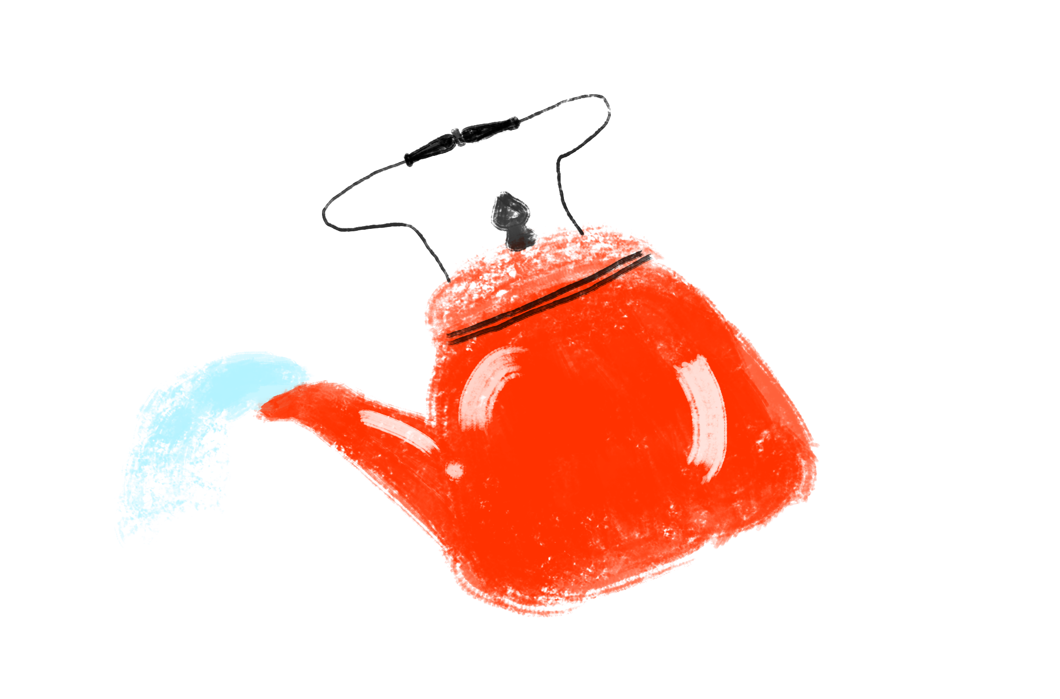
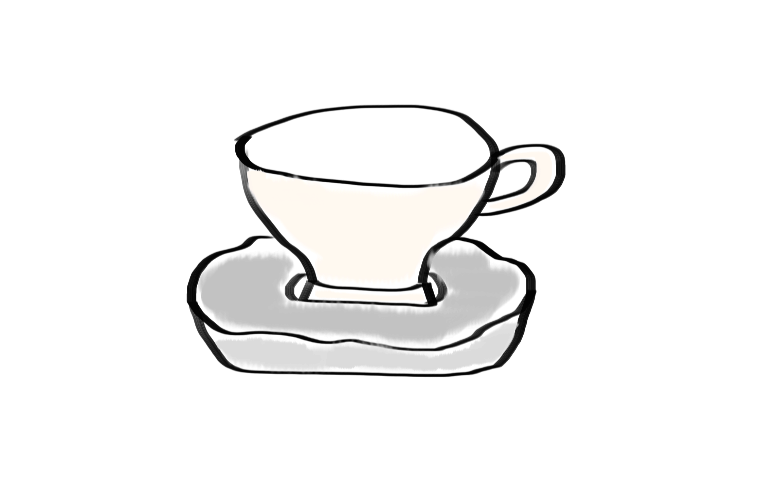
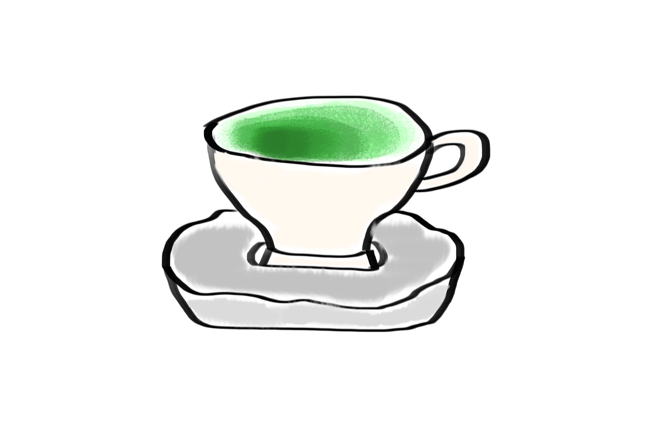
The three teas Sir Stochastic drinks …
Rice
Green
Black

Slide 8
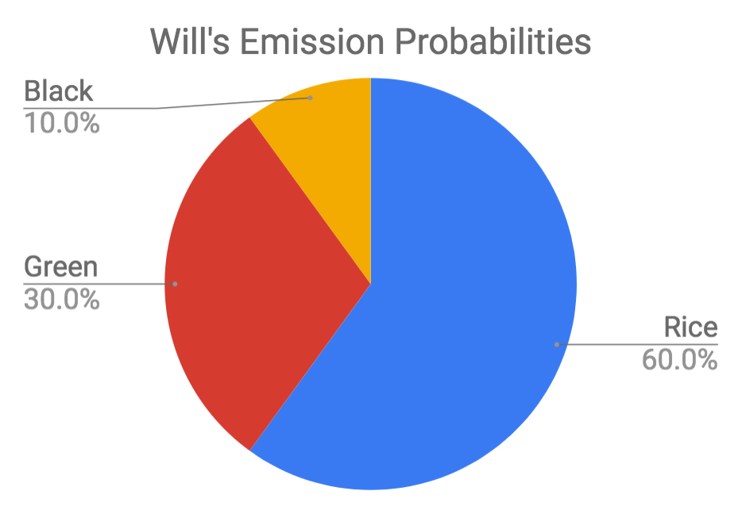

Slide 9
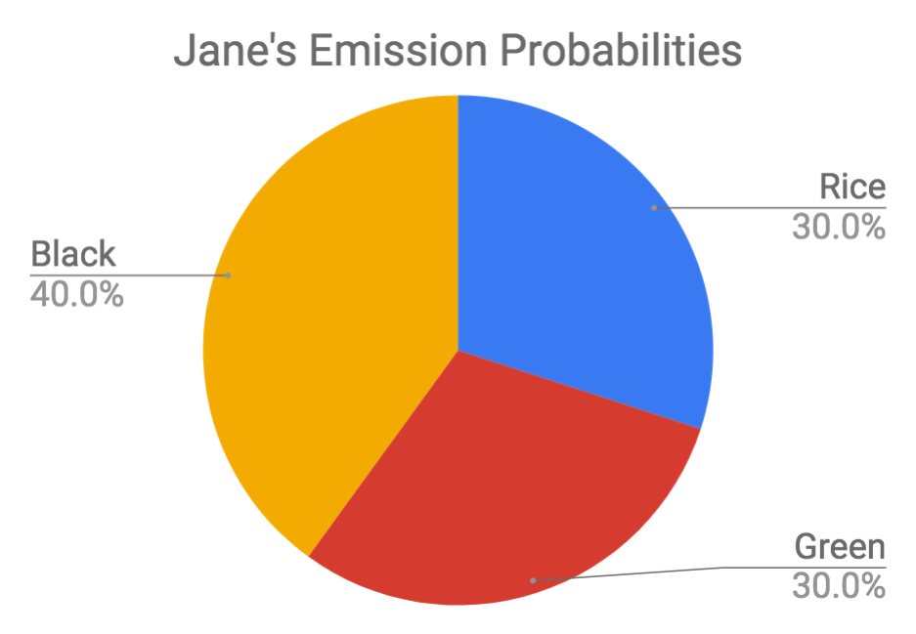

Slide 10
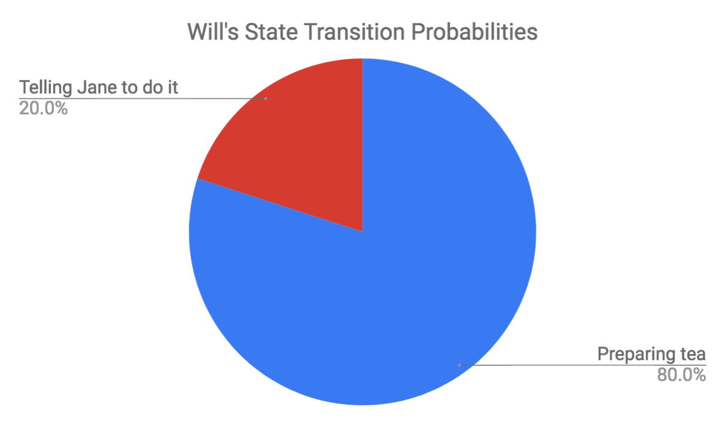

Slide 11
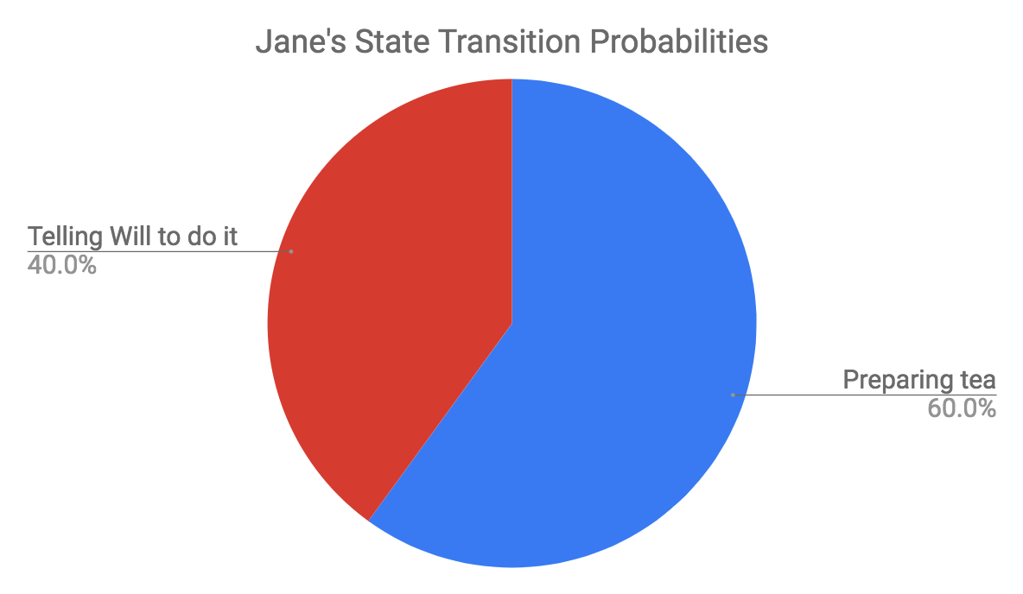

Slide 12
3 days ago
2 days ago
Yesterday
Today
Rice
Black
Green
Black
Observation Sequence
(flavors of tea observed)

Slide 13
Maximum Likelihood
a.k.a what’s the most likely sequence to have occurred??

Slide 14
^ Bayes Theorem (calculates the probability of an event occurring, taking into account other factors that influence the likelihood of that event)

Slide 15
0.3
0.6
Will
Will
Will
Will
0.8
0.4
2/3
Jane
0.2
Jane
Jane
Jane
0.6
1/3
**Use the Viterbi Algorithm
Probability for Will to Jane: 0.6 * 2/3 * 0.2

Slide 16
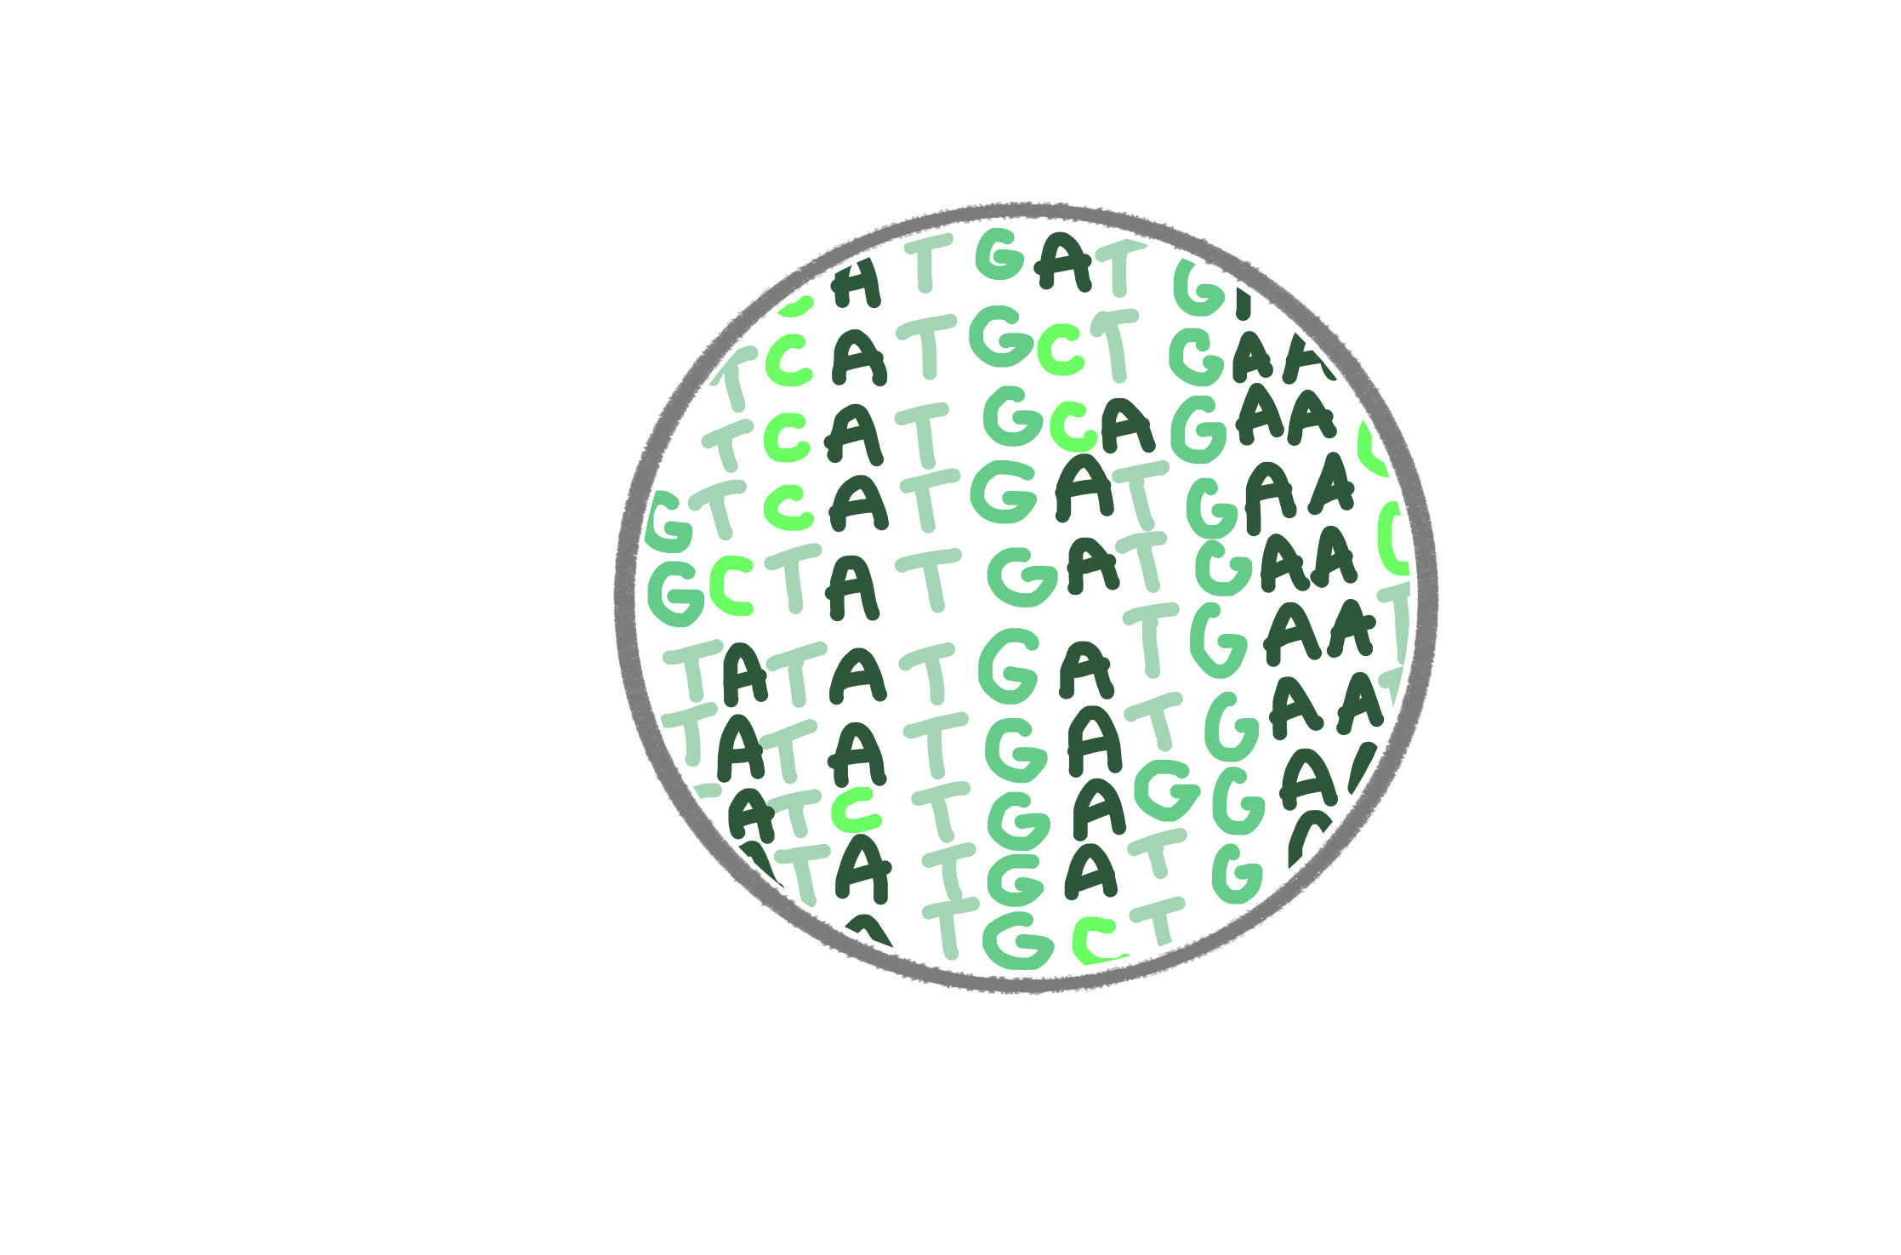
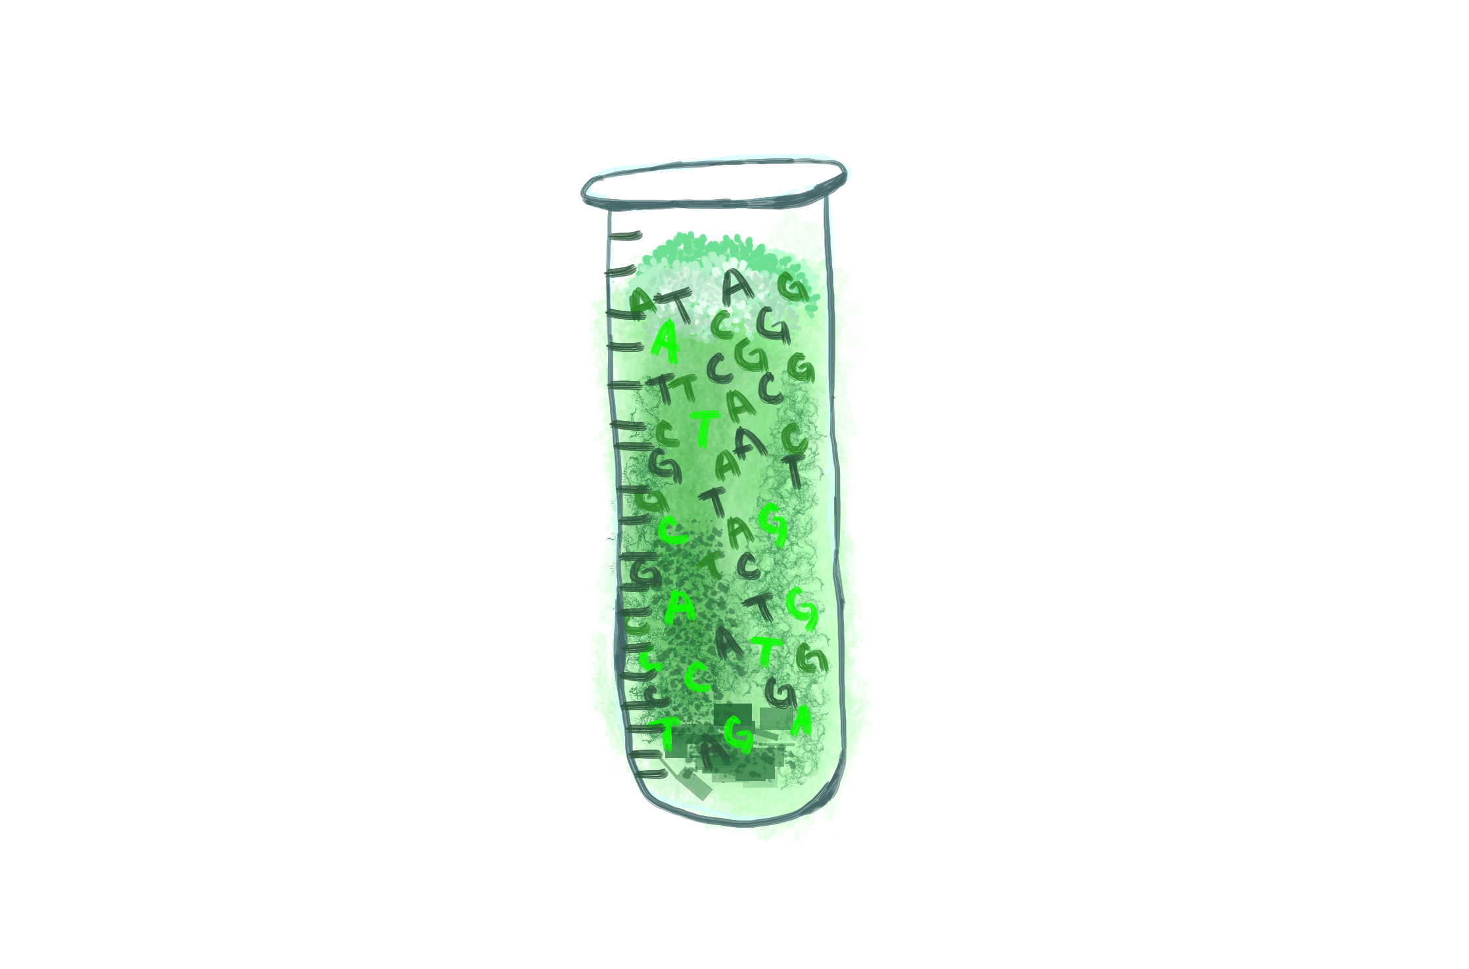
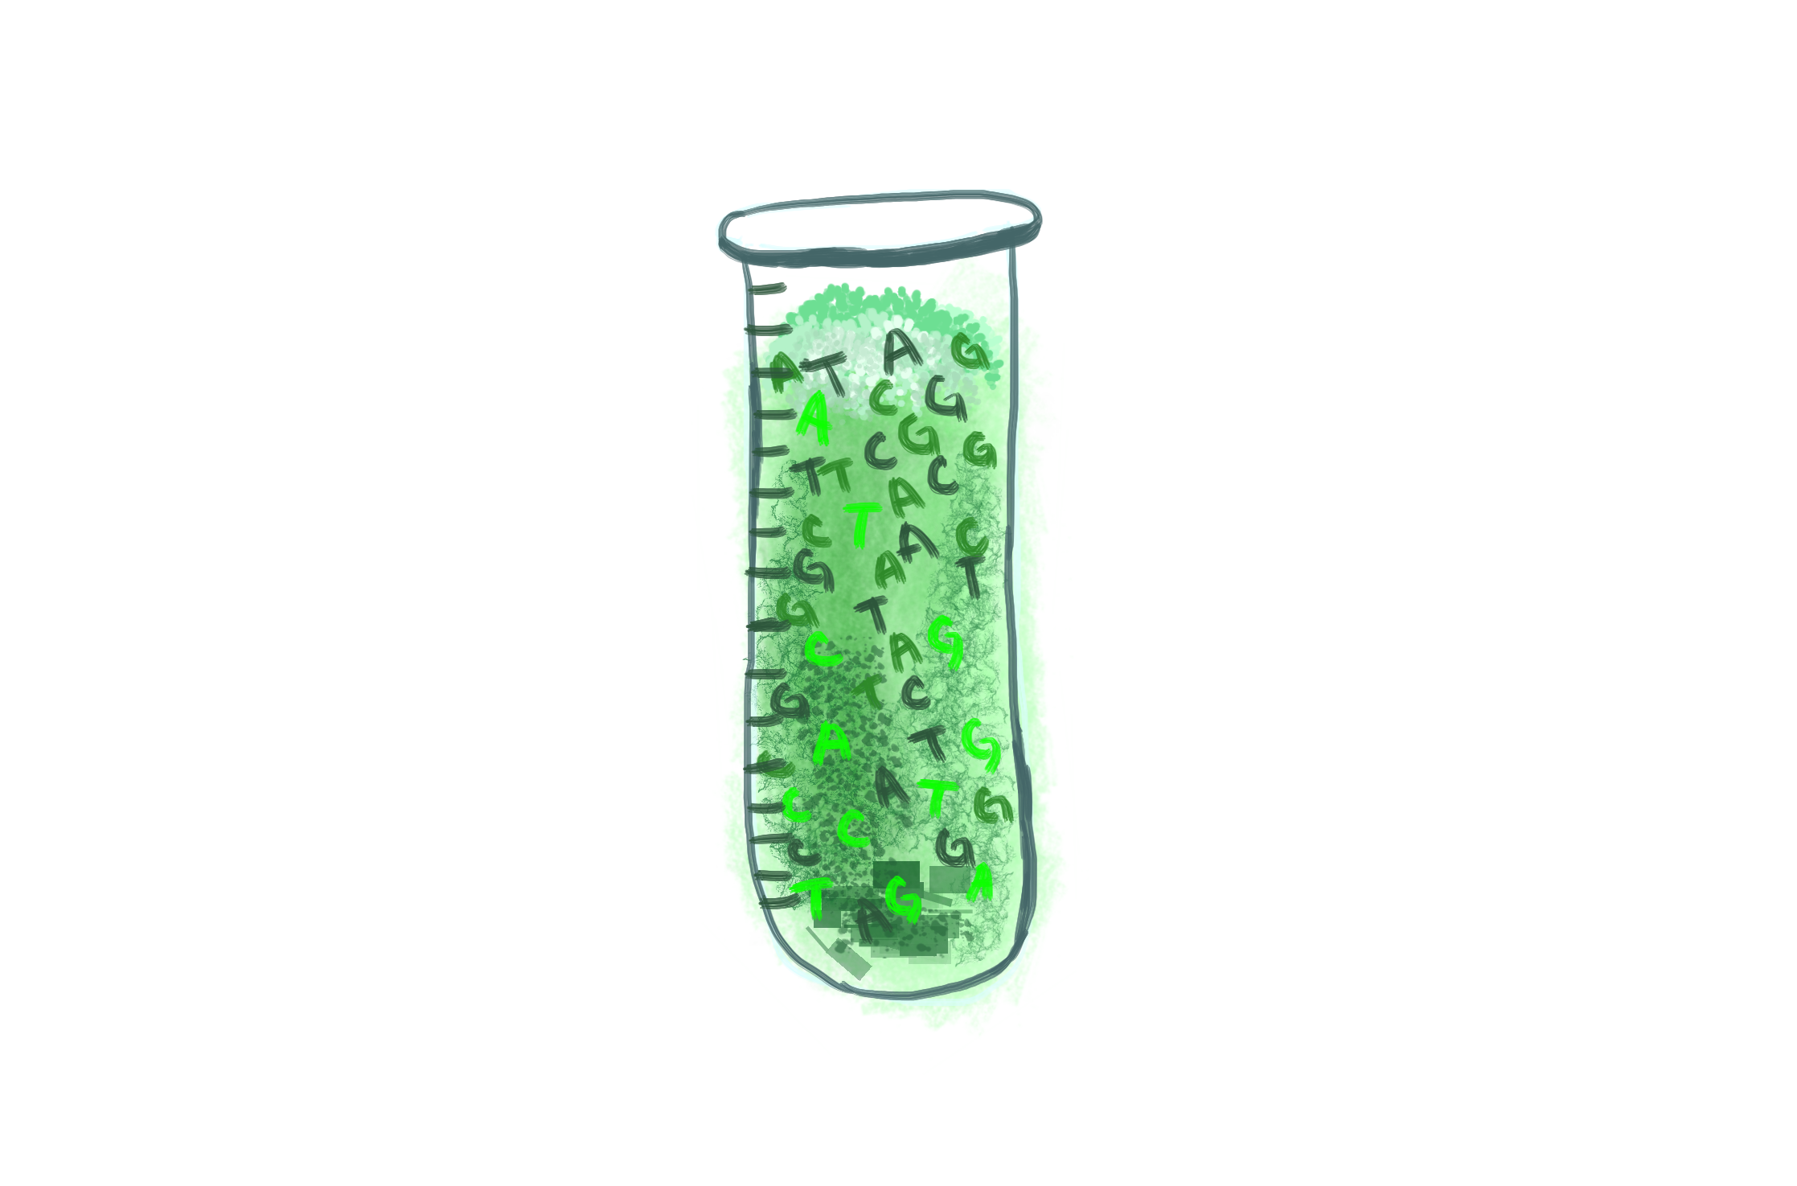
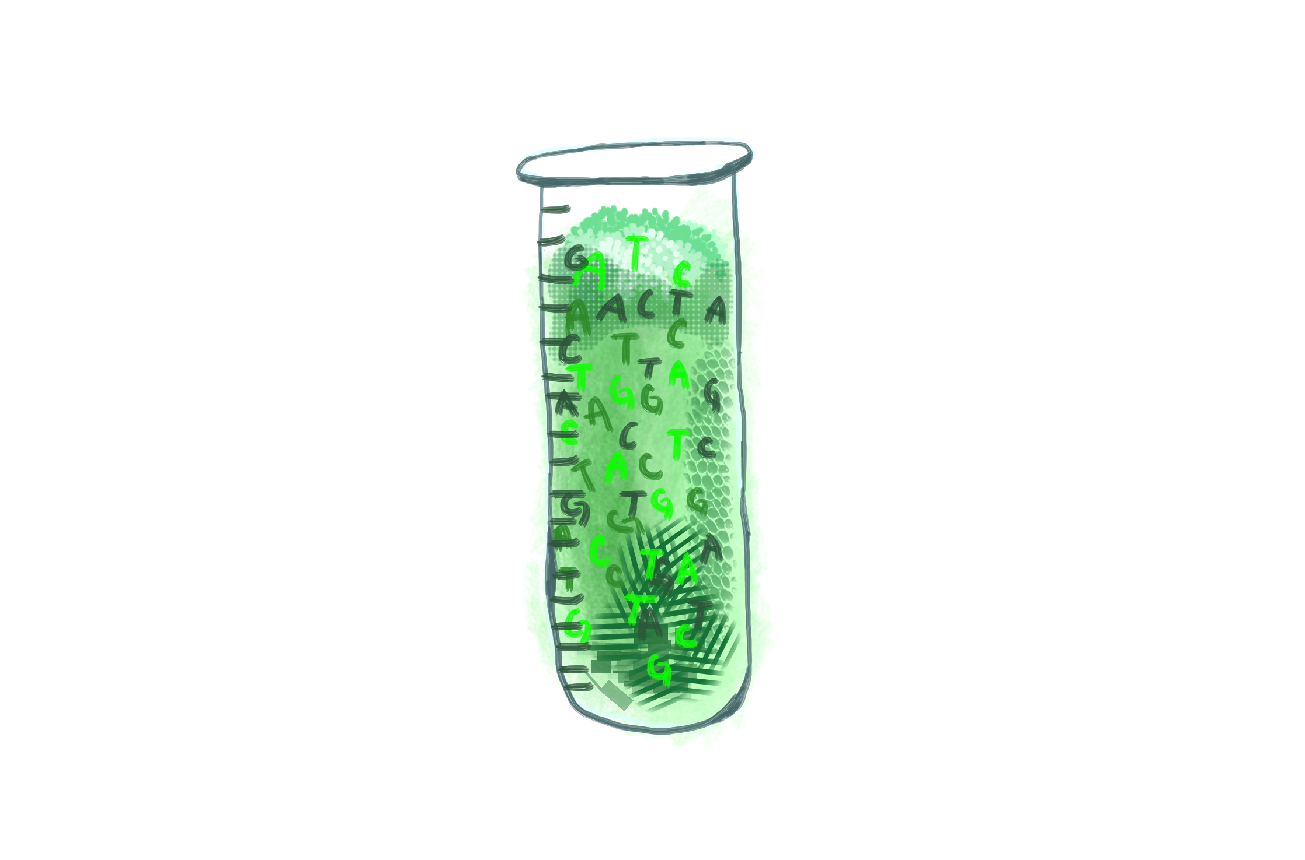
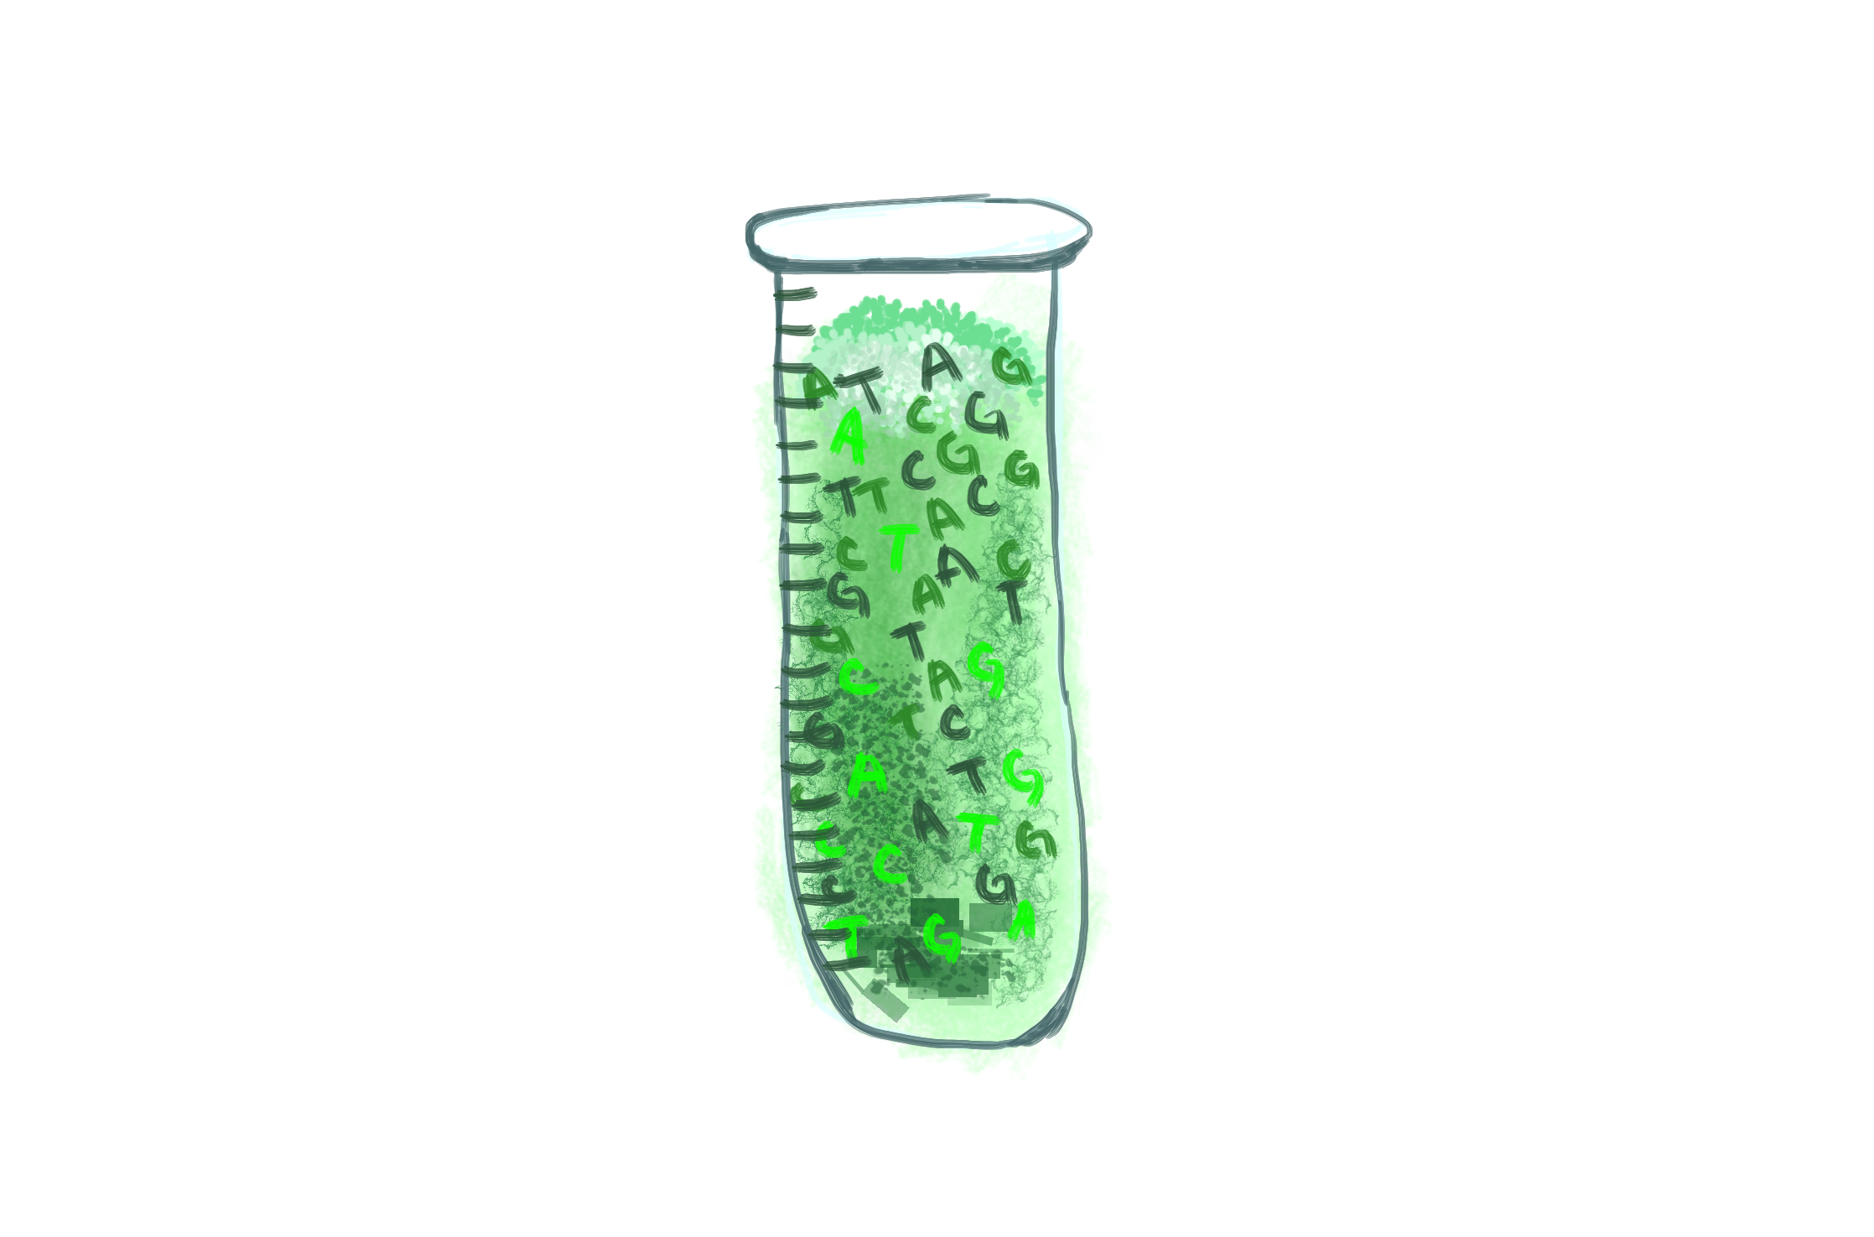
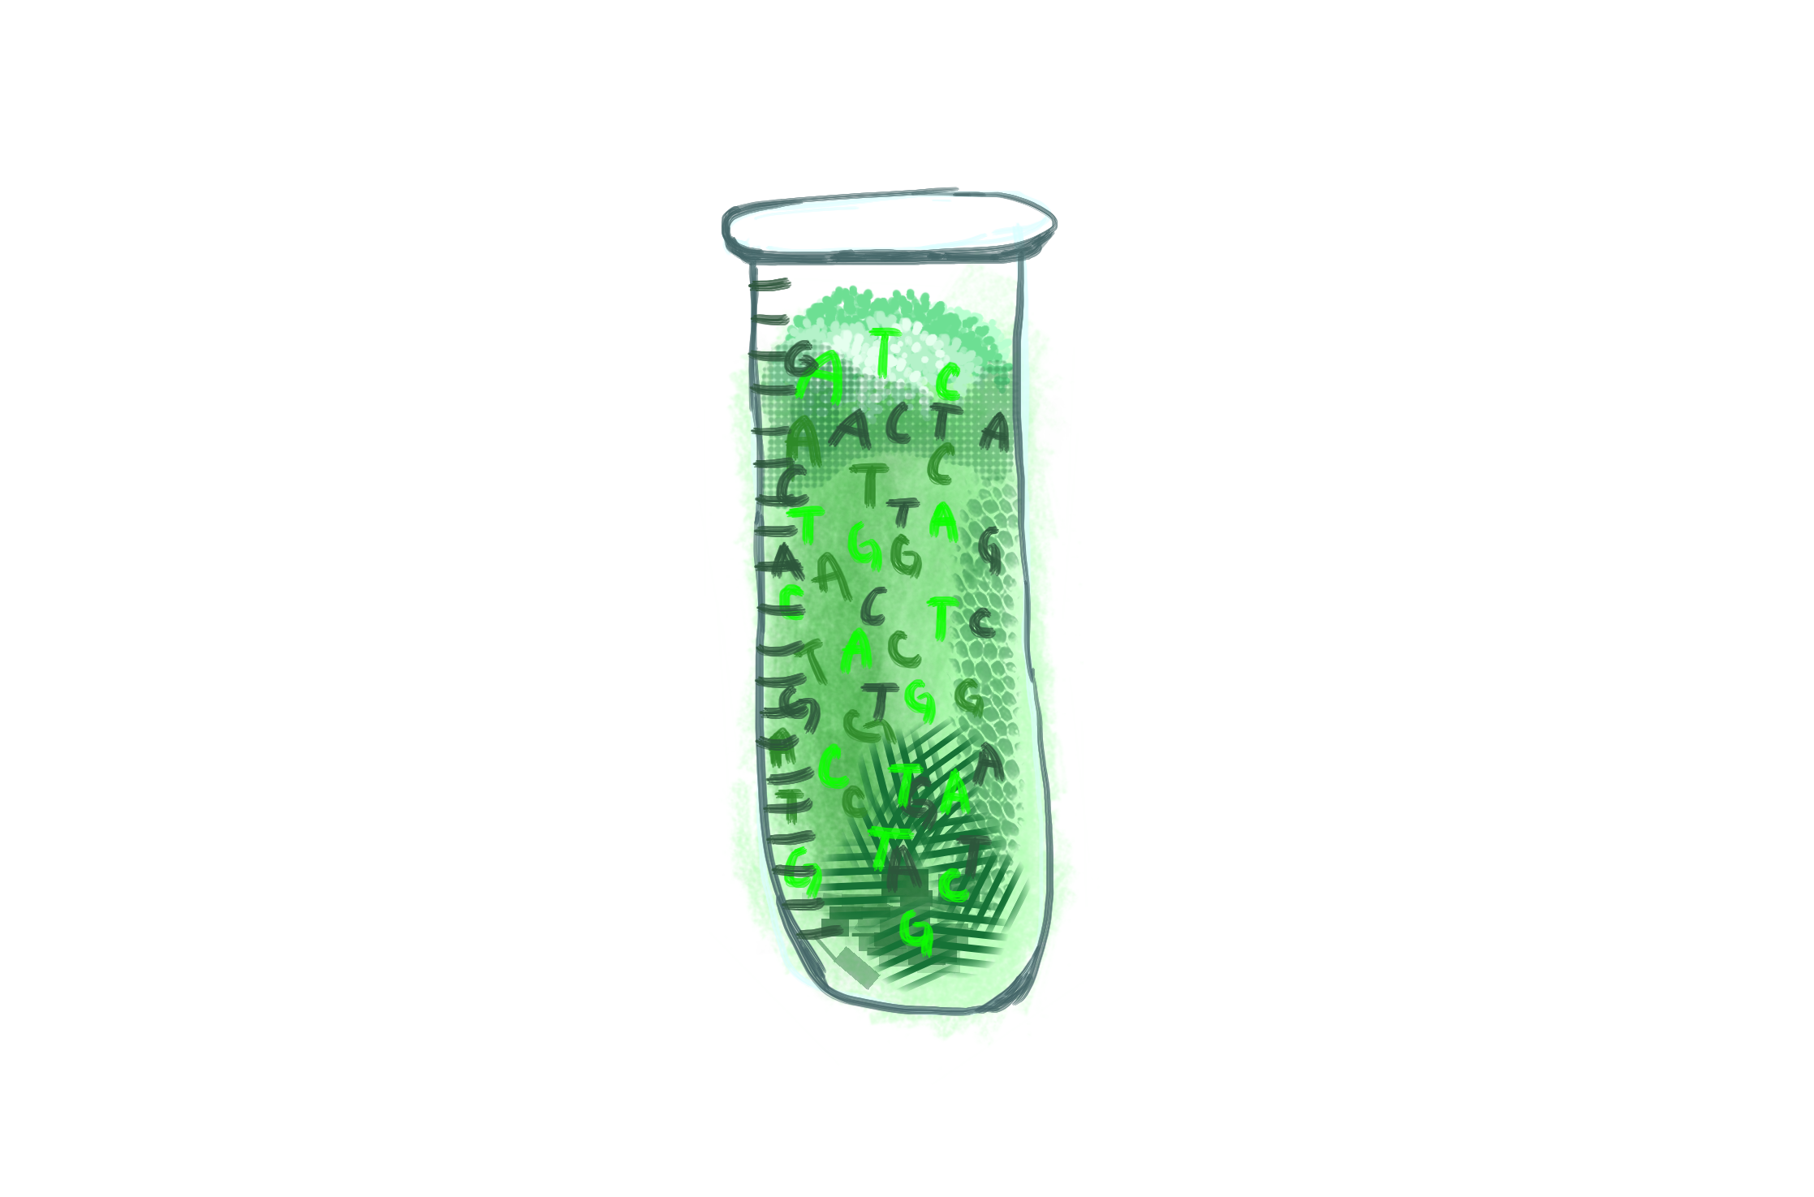
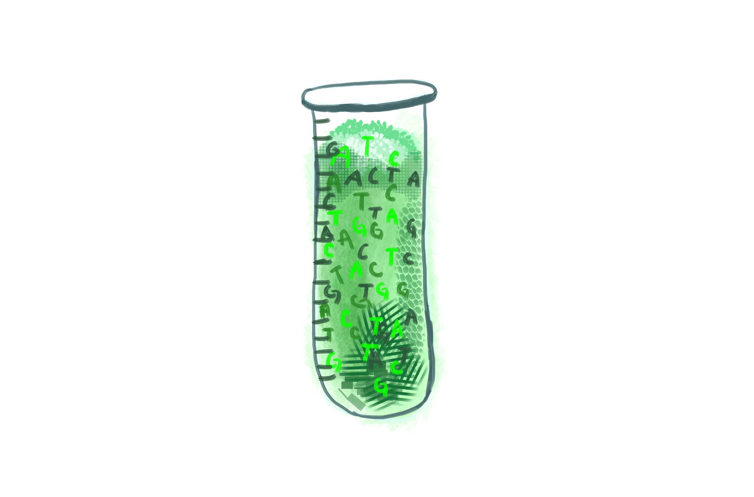
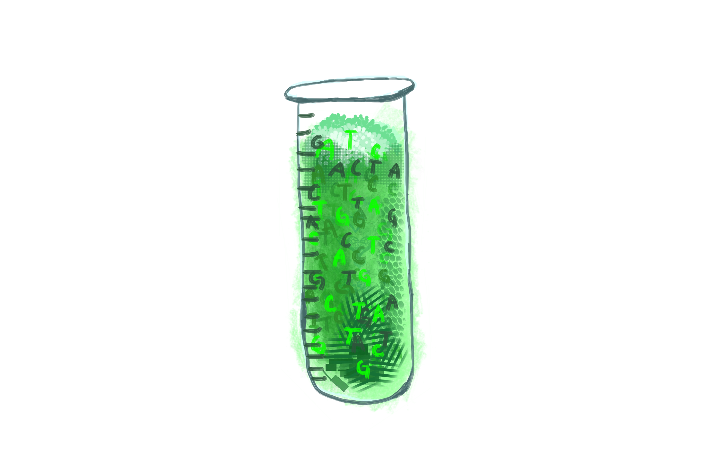
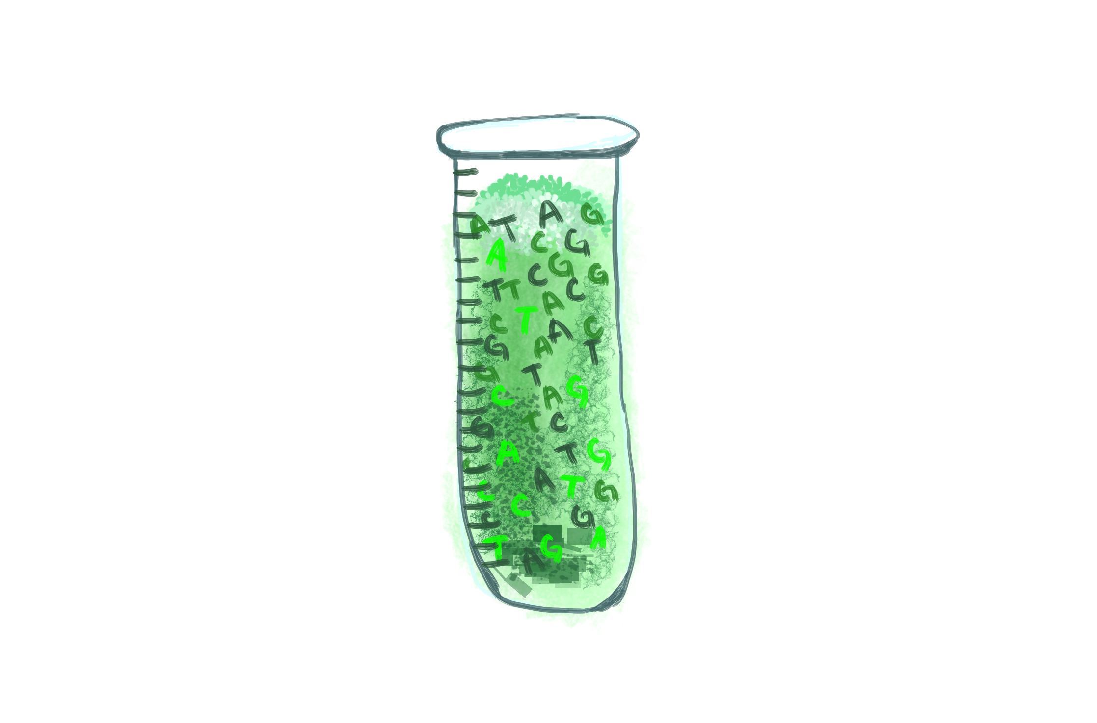
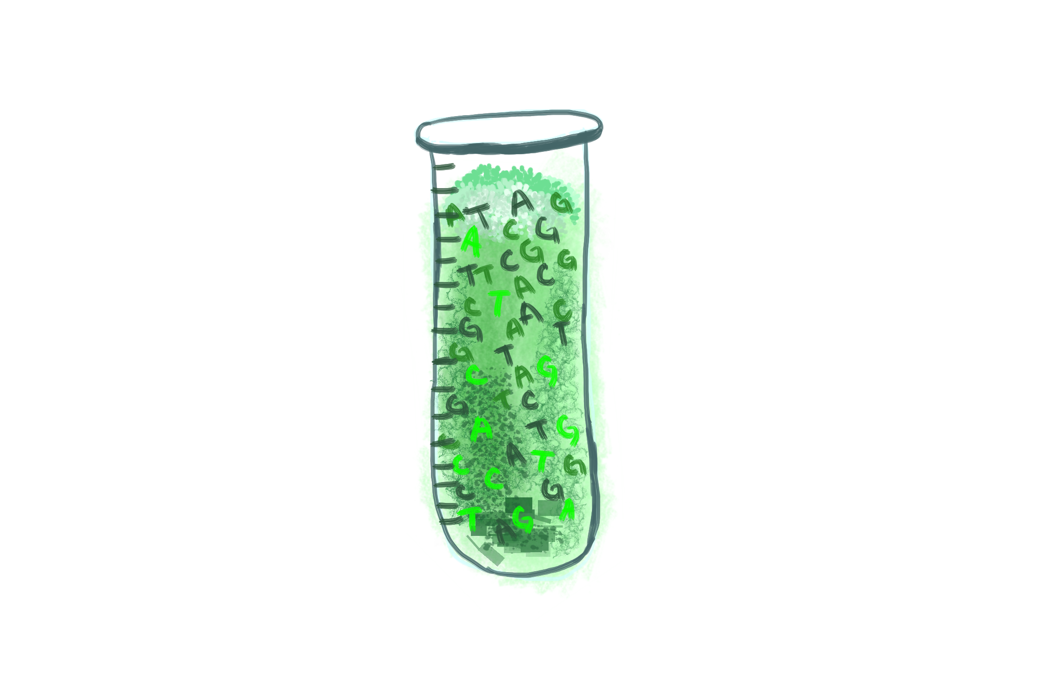
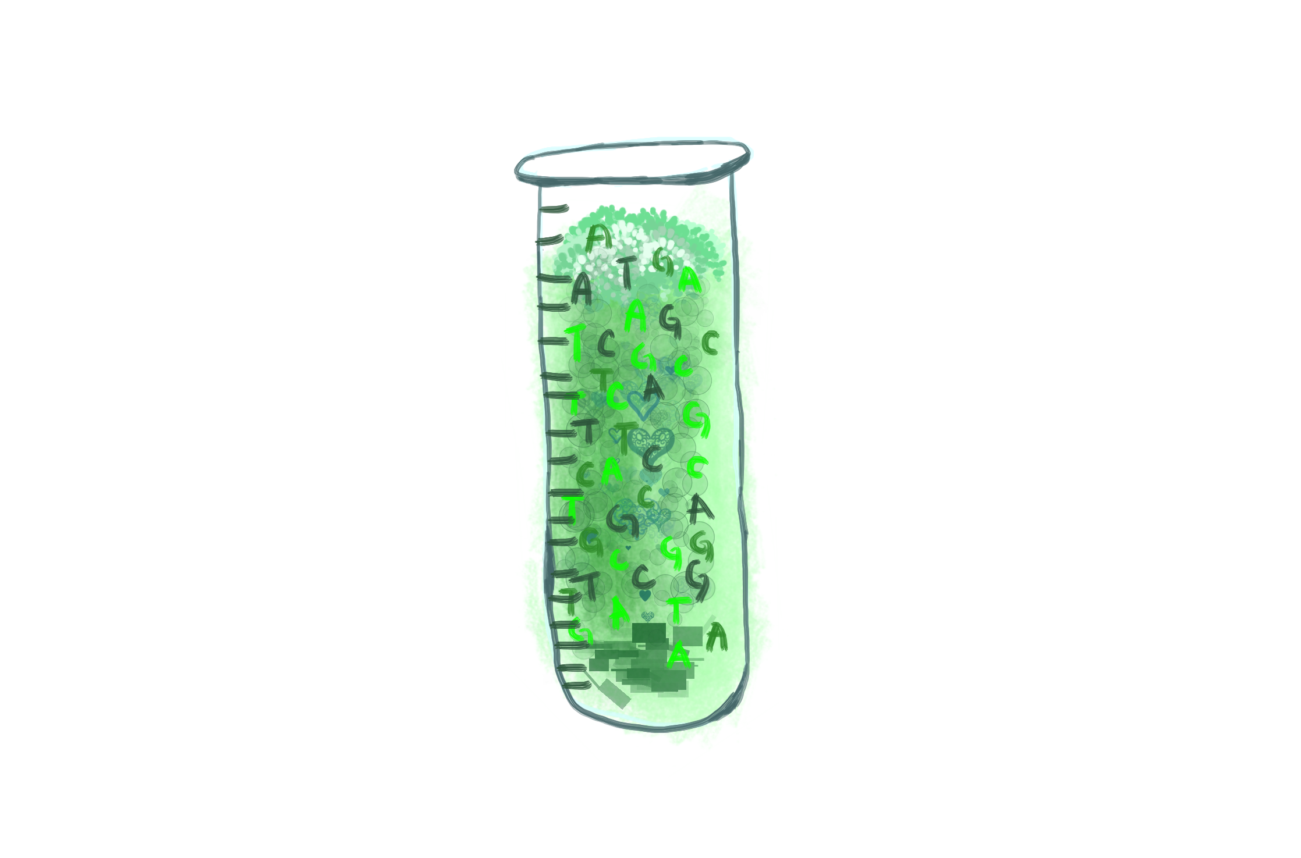

Slide 17
probabilistic sequence models
label
unit

Slide 18
unknown order of tea makers → hidden state sequence

Slide 19

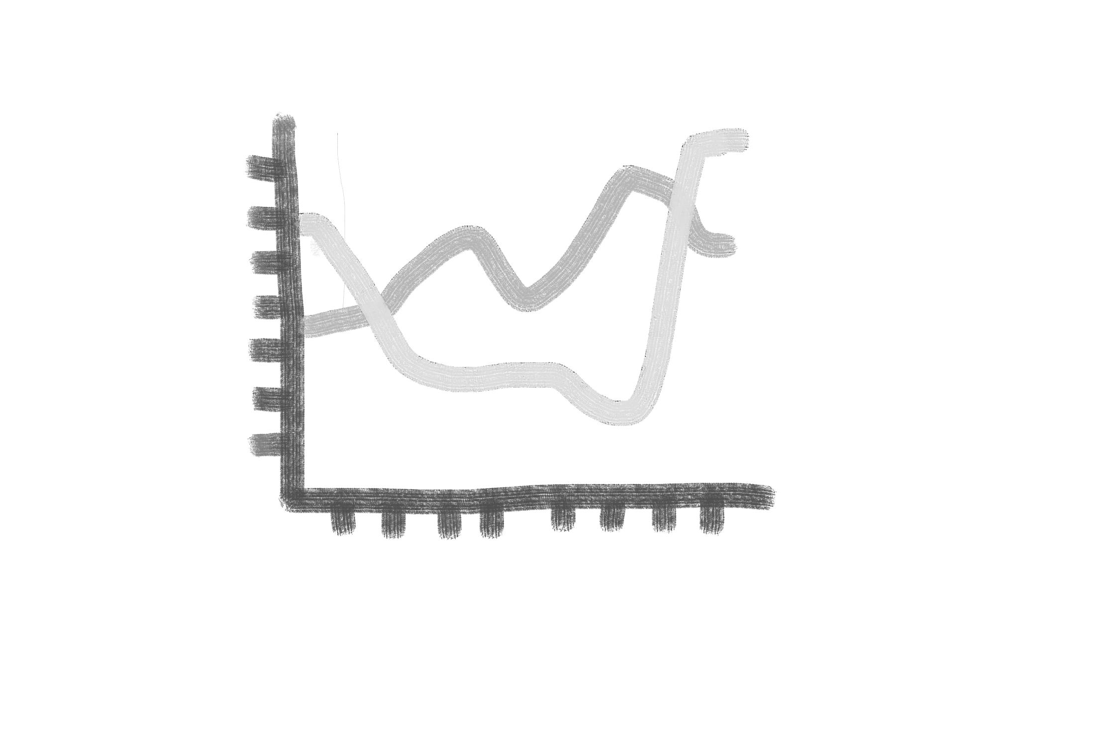




Computational finance
Cryptanalysis
Time-series analysis
Part of speech
tagging
Speech recognition/synthesis
Machine translation

Slide 20

